Slide 1
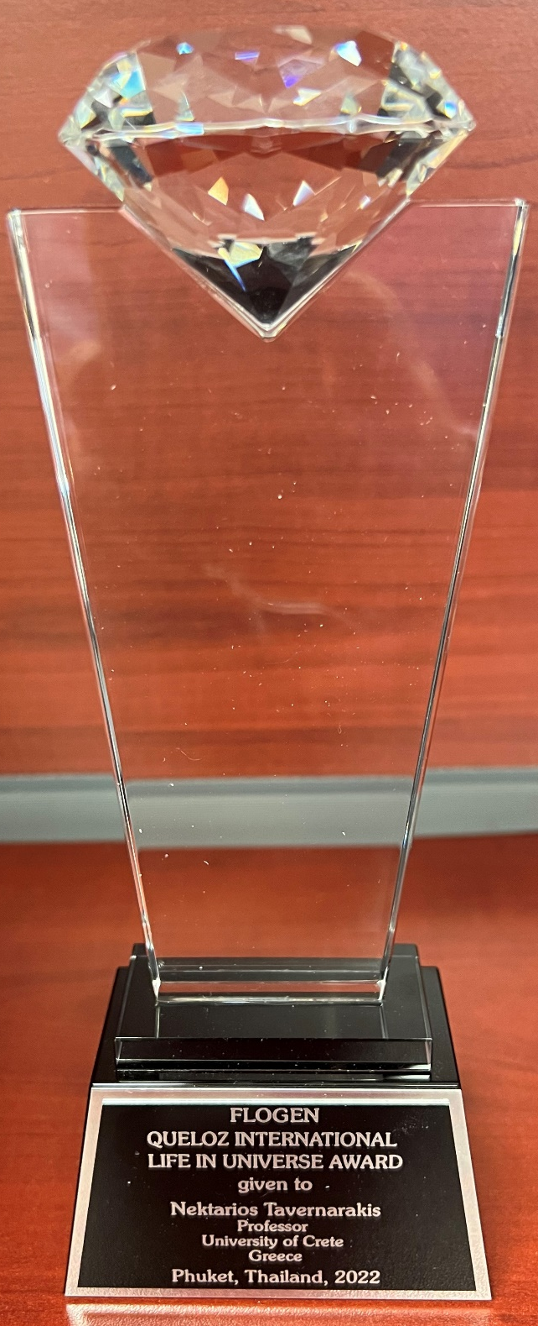
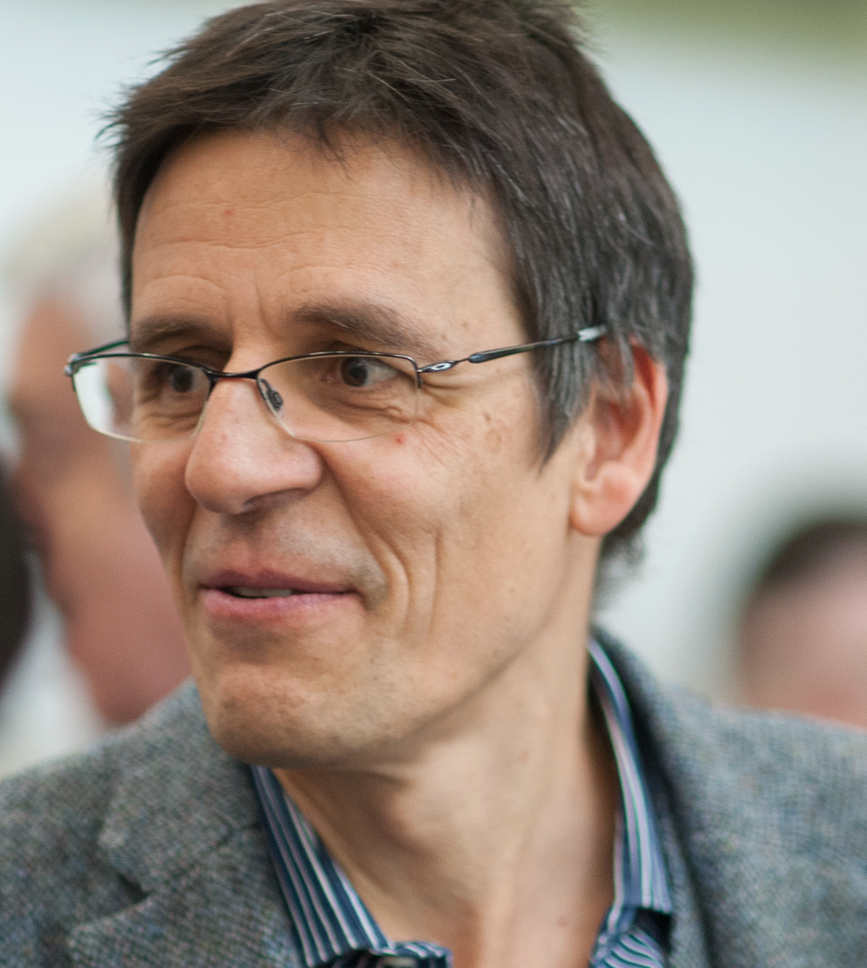
International Life in Universe Award
An Award in honor of the lifetime achievements of Prof. Didier Queloz, 2019 Nobel Laureate in Physics, and his distinguished work related to Life in the Universe.
Citation:
”For leadership in developing new fundamental principal and theories related to life in universe as per FLOGEN Sustainability Framework in the environmental, economic and social points of view”.

Slide 2
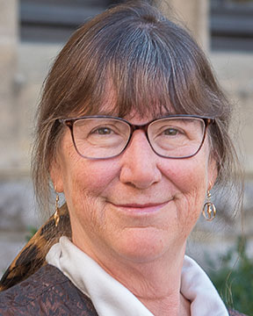
Sustainable Industrial Processing Summit
2024 STARS:
Nancy L. Ross
Professor
Virginia Tech, USA
Field: Geochemistry
INTERNATIONAL LIFE IN UNIVERSE AWARD
FLOGEN STARS OUTREACH

Slide 3
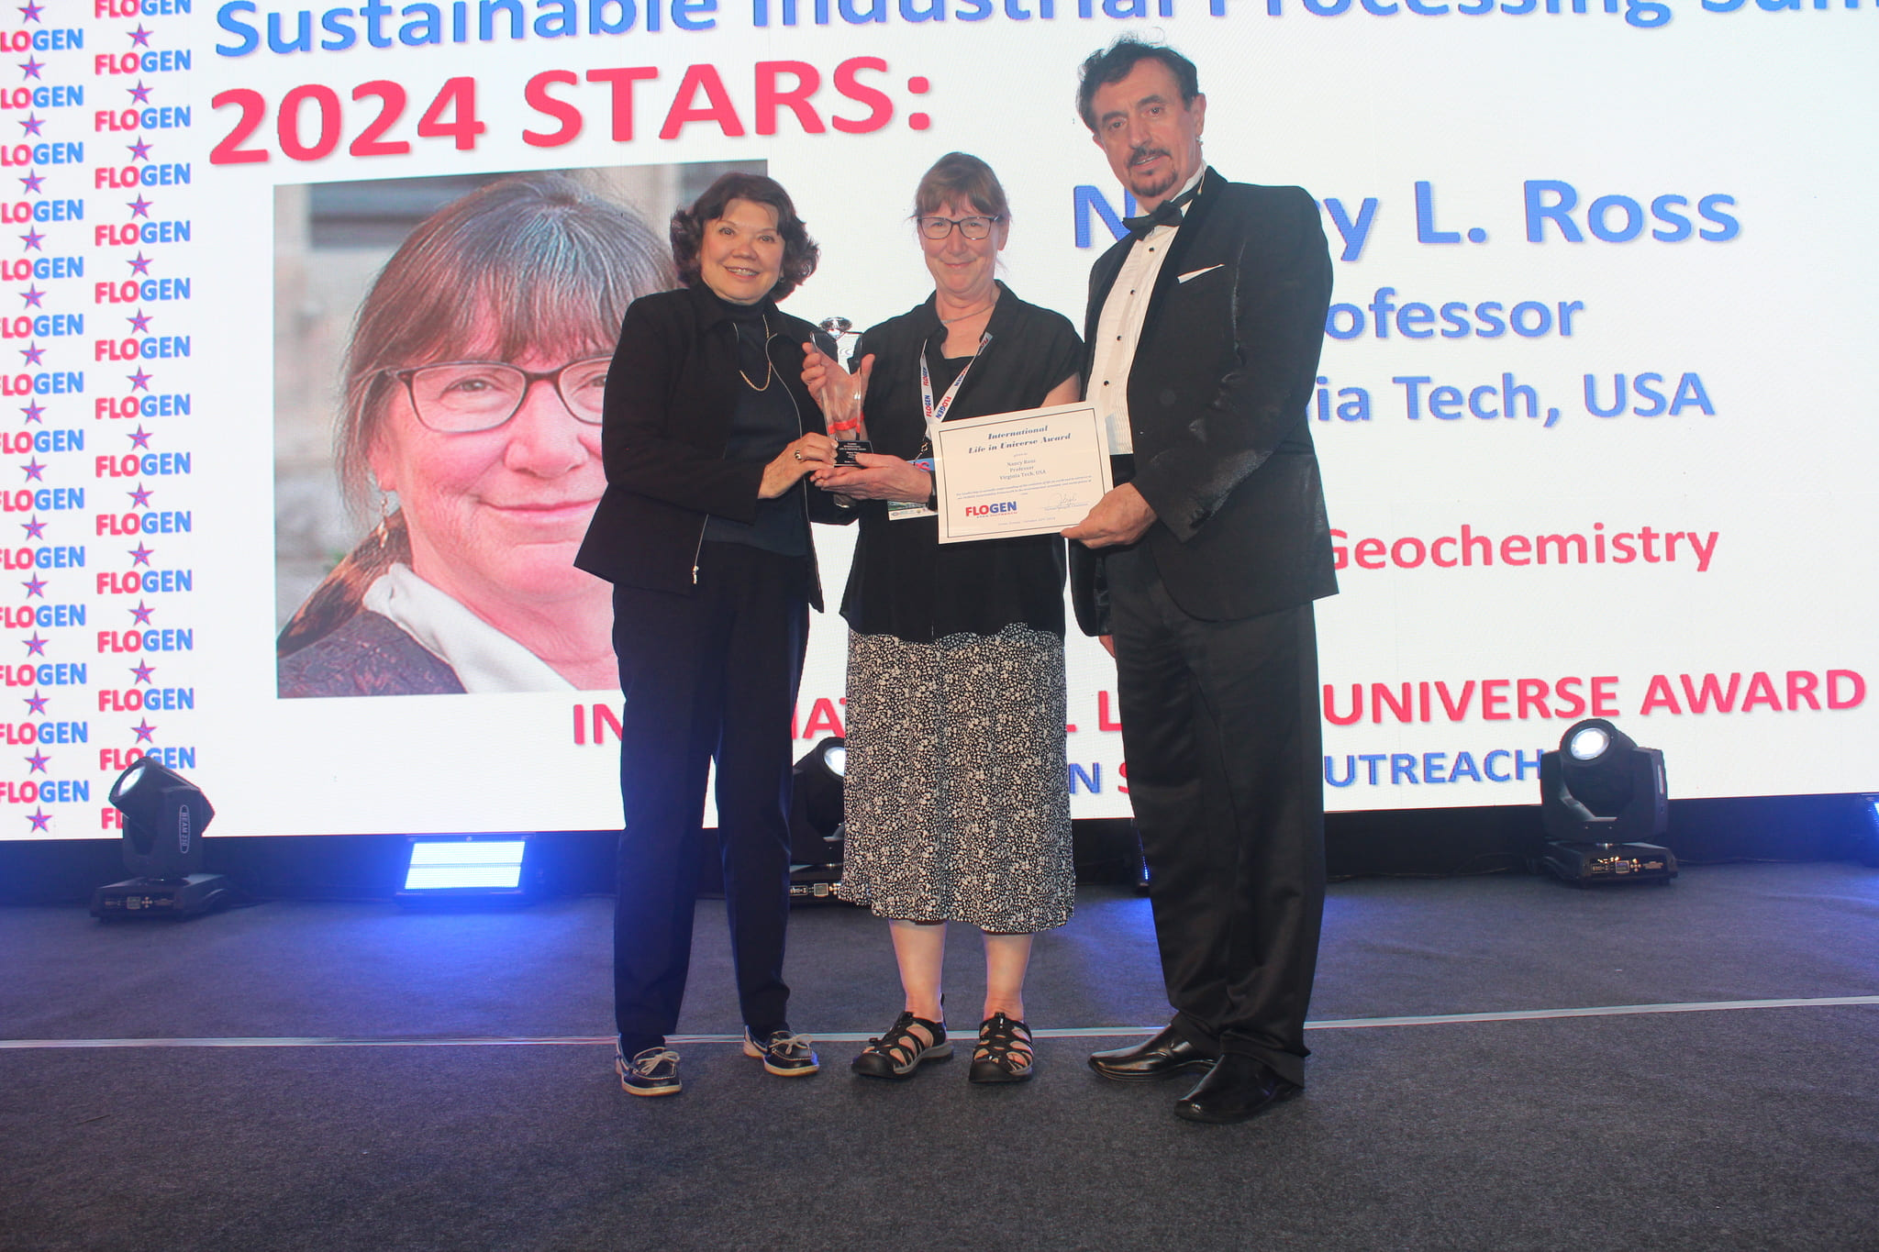
Dr. Nancy Ross receiving the International Life in Universe Award from Dr. Florian Kongoli at FLOGEN SIPS 2024

Slide 4
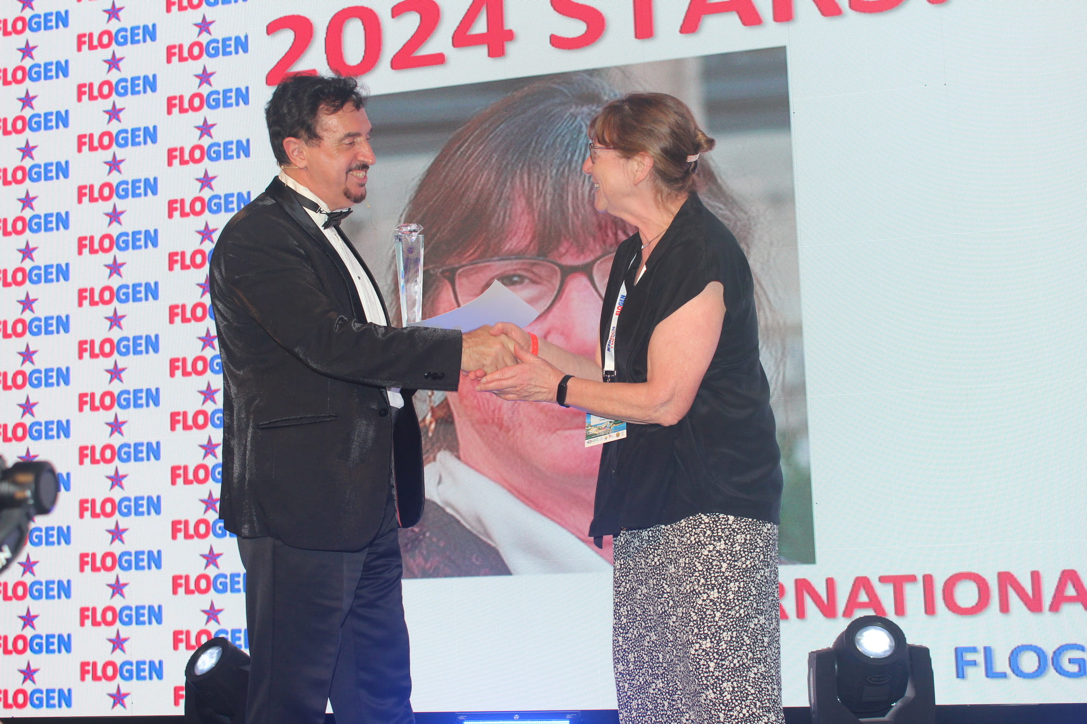
Dr. Florian Kongoli congratulating Dr. Nancy Ross during the FLOGEN SIPS 2024 award ceremony

Slide 5
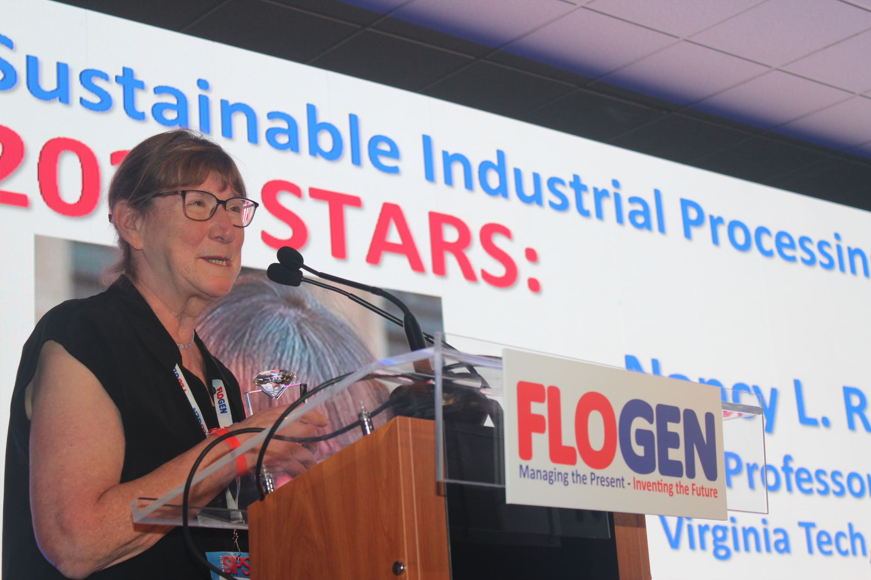
Dr. Nancy Ross delivering an acceptance speech during the FLOGEN SIPS 2024 award ceremony

Slide 6

Early Days

Slide 7
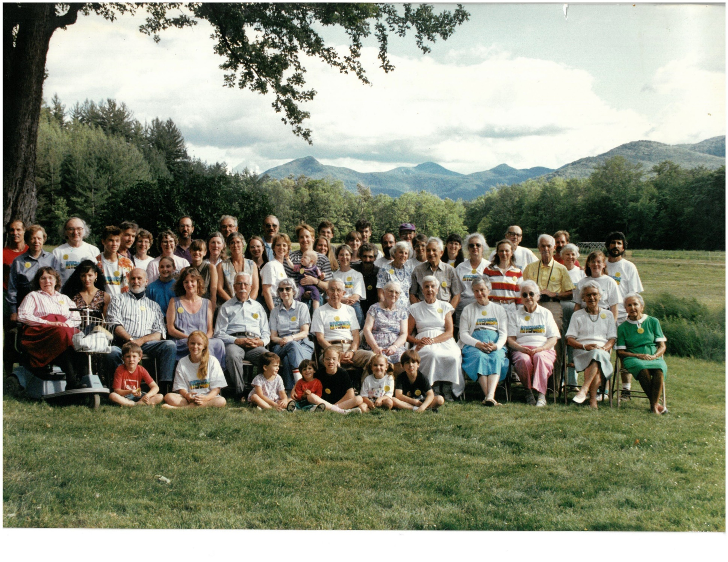
Ross Family Reunion, Keene Valley, NY, 1984

Slide 8
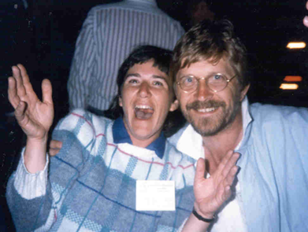
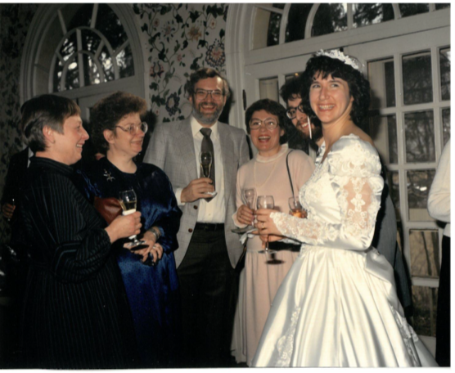
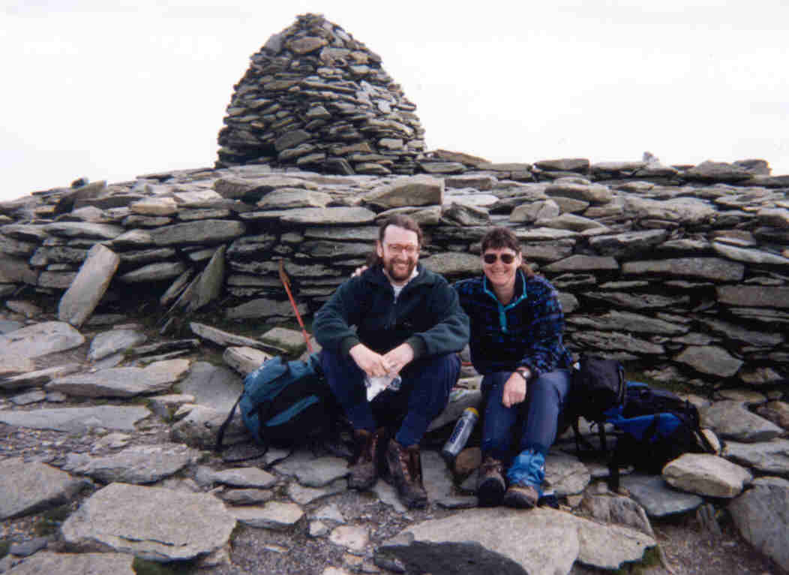
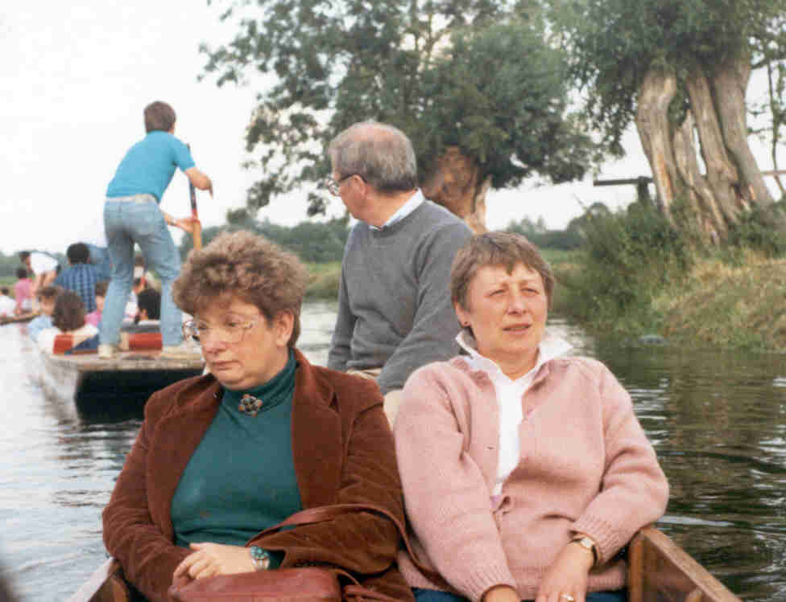
With Andrew Putnis
1984 IMA Meeting, Stanford, CA
Nancy and Ross with Denise and Larry Finger Alex Navrotsky and Gretchen Prewitt, 1988
Hiking in the Lake District, UK
Punting in Cambridge with Alex Navrotsky, Gretchen and Charlie Prewitt

Slide 9
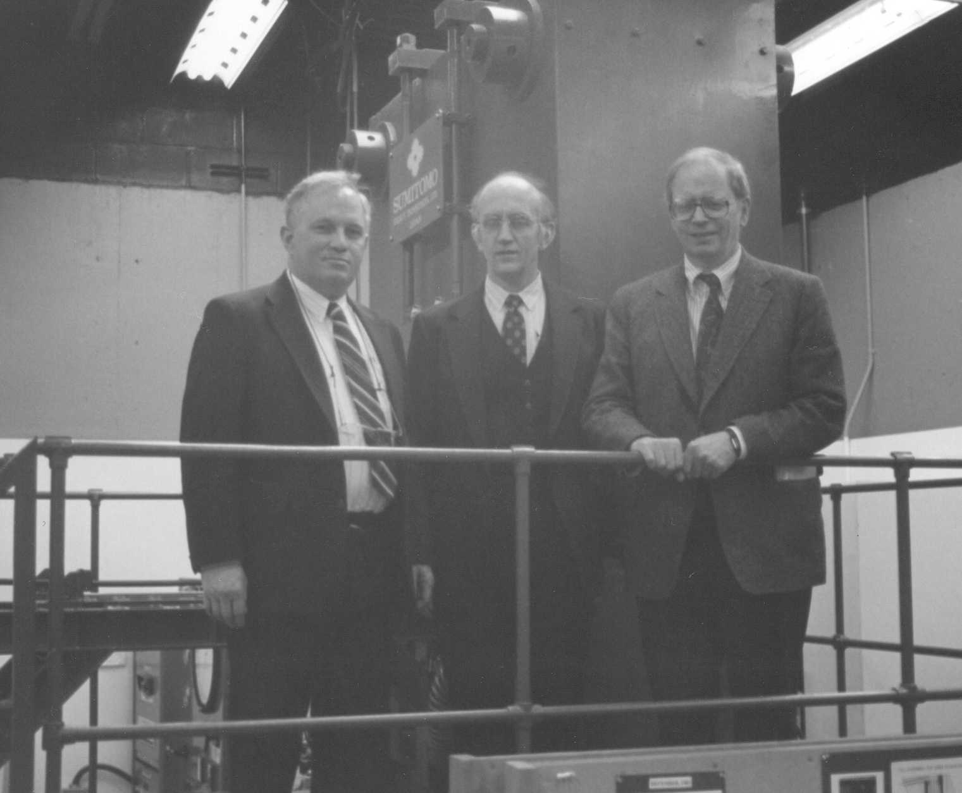
Bob Liebermann, Don Weidner, Charlie Prewitt
Stony Brook, NY, 1985
Ross Angel and Charlie Prewitt
Stony Brook, NY, 1986

Slide 10

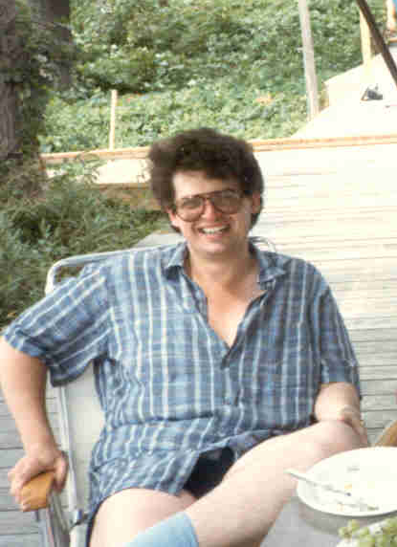
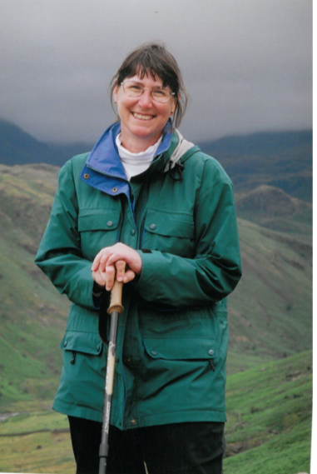
David Price
UCL, 1988-2000

Slide 11
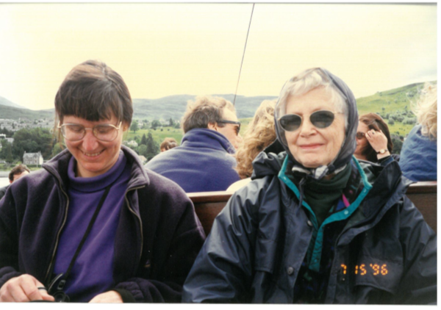
Family trips, 1990’s

Slide 12
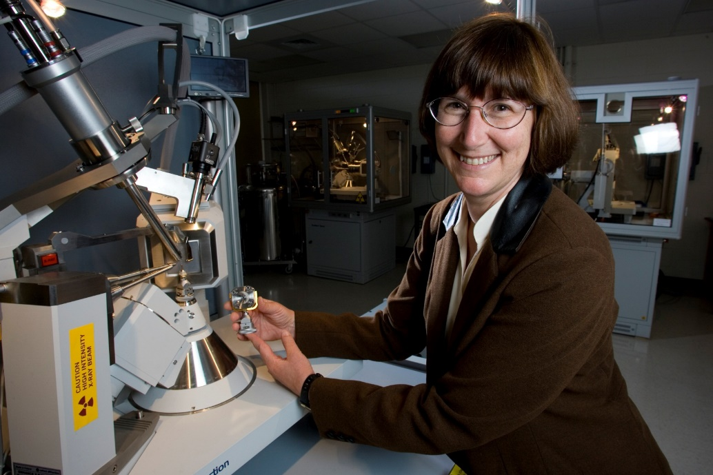
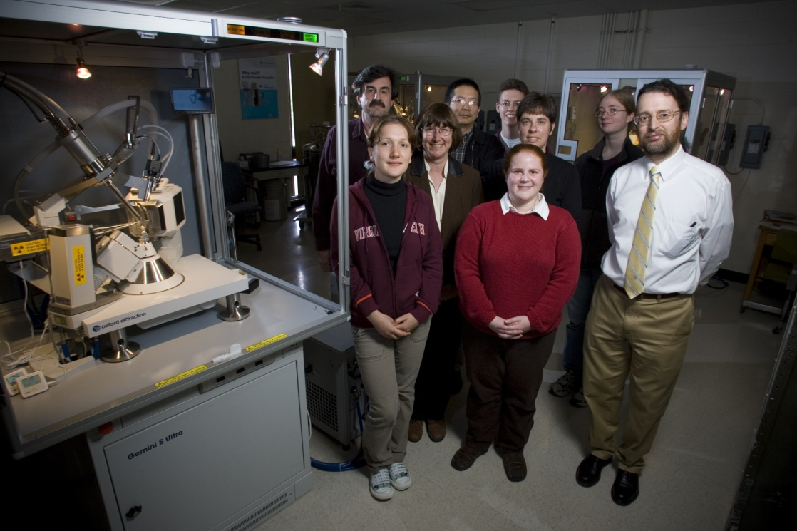
Crystallography Research Group, 2008

Slide 13
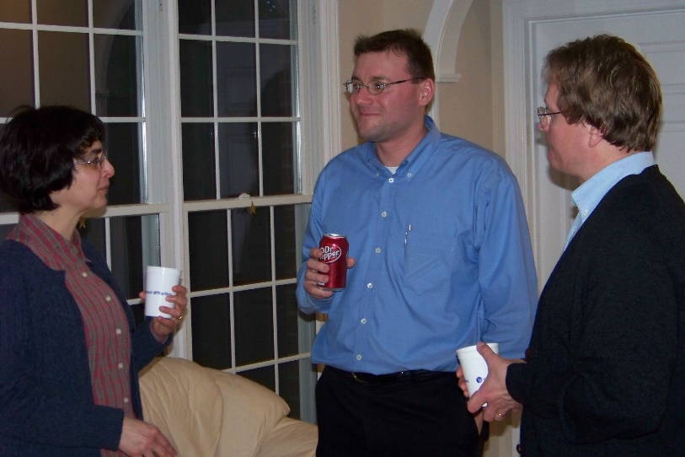
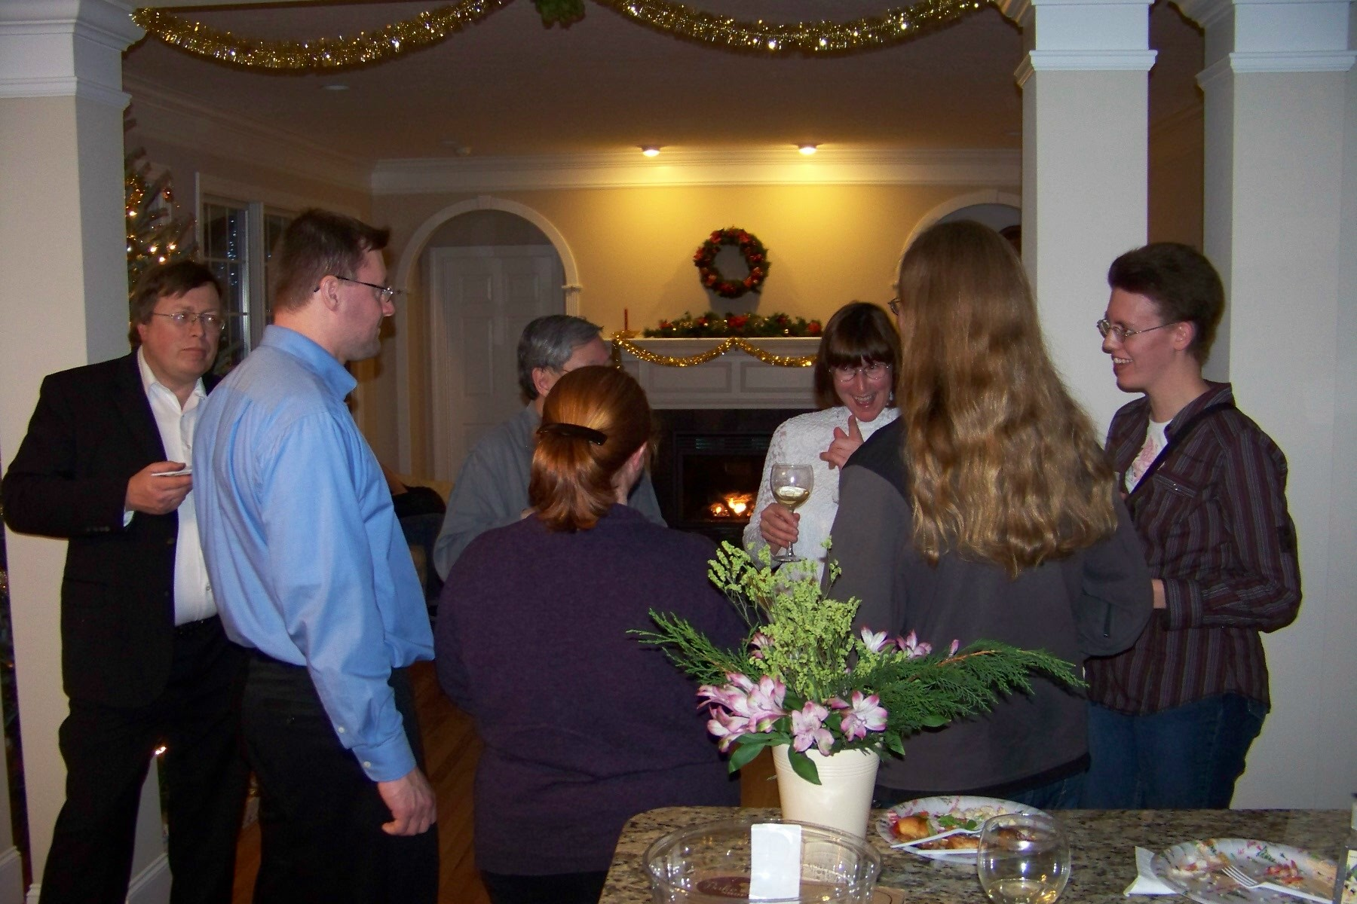
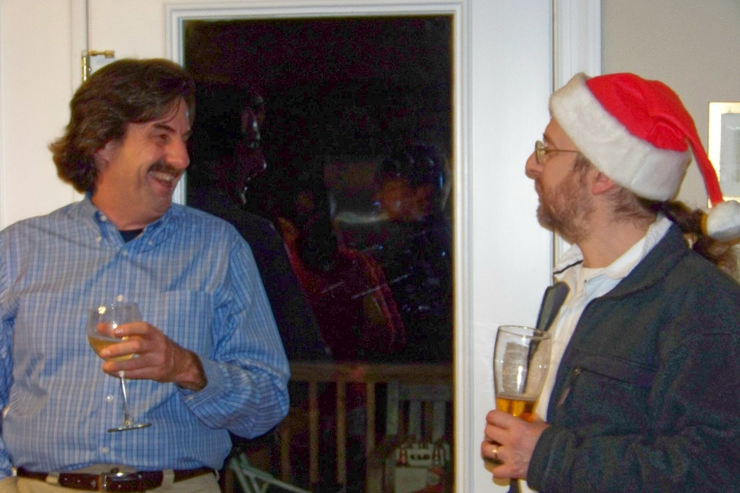
Crystallography Group Xmas Party, 2009

Slide 14
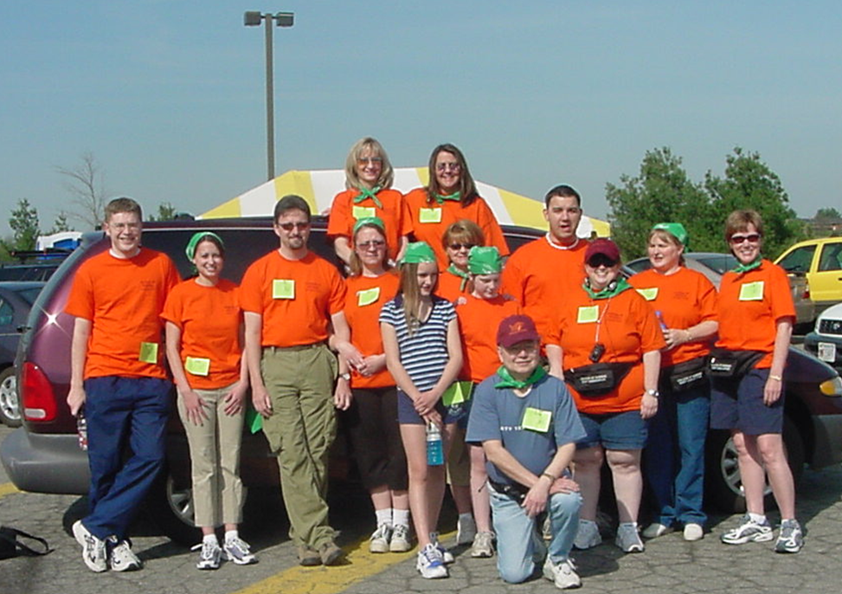
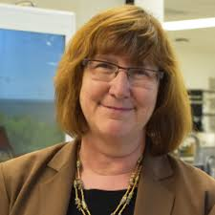
Associate Dean, College of Science, 2003- 2012
Dean Lay Nam Chang and the College of Science Staff

Slide 15

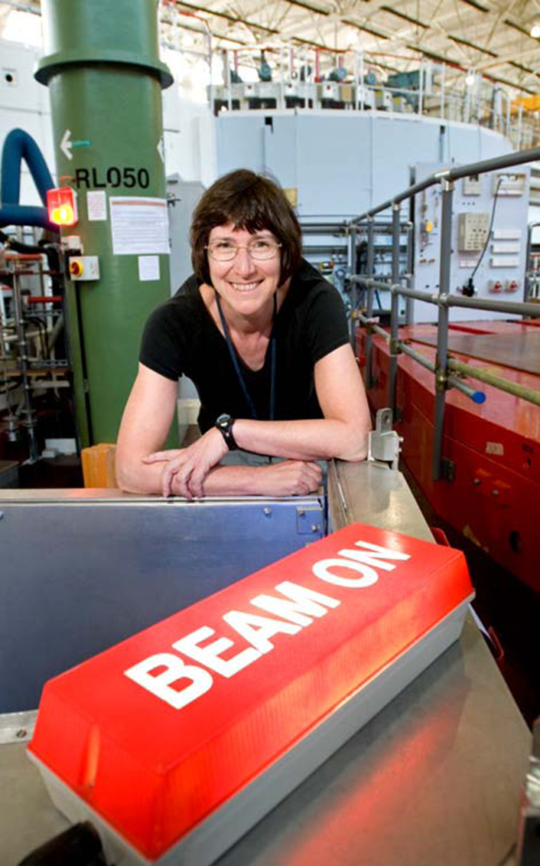
Experiments at Rutherford Appleton Laboratory, UK, 2012

Slide 16
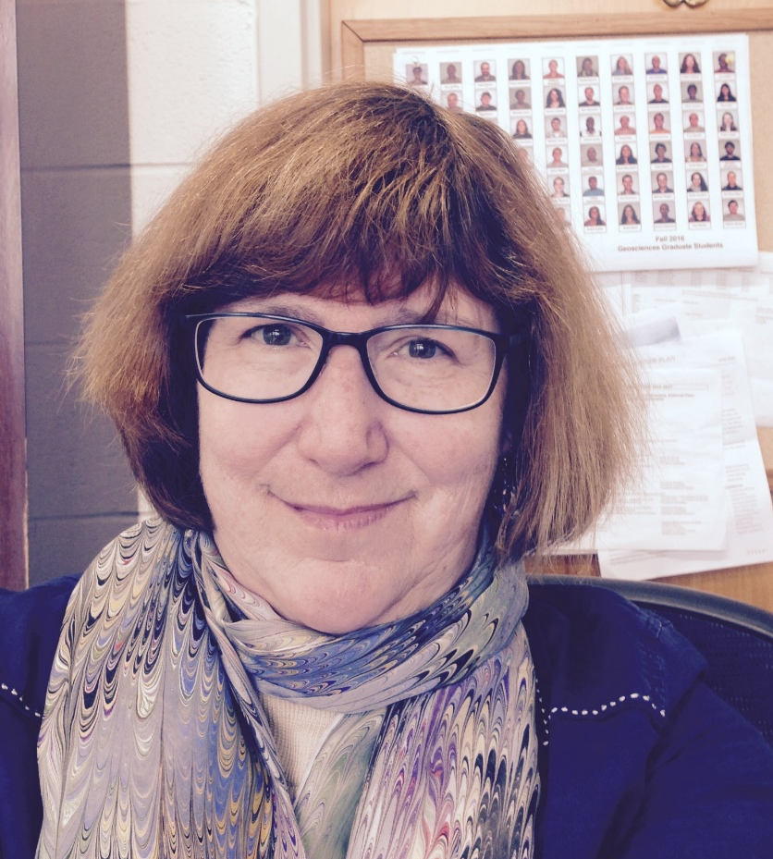
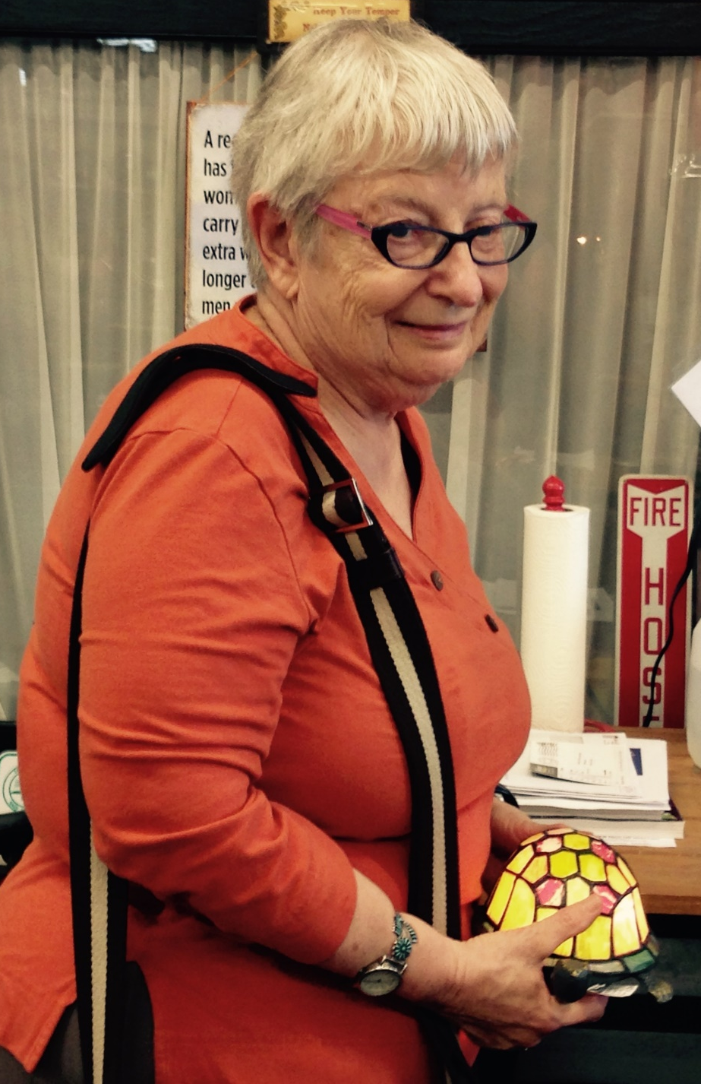
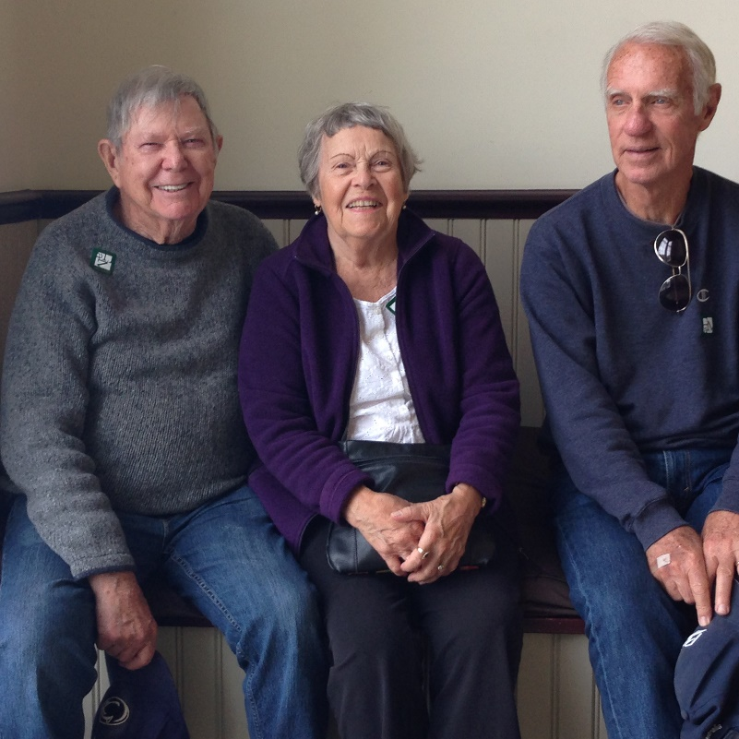
Jerry Gibbs, Joan Campbell and Pat Meagher, 2017
Head of Department of Geosciences,
2012-2017
Alex visit in 2017

Slide 17
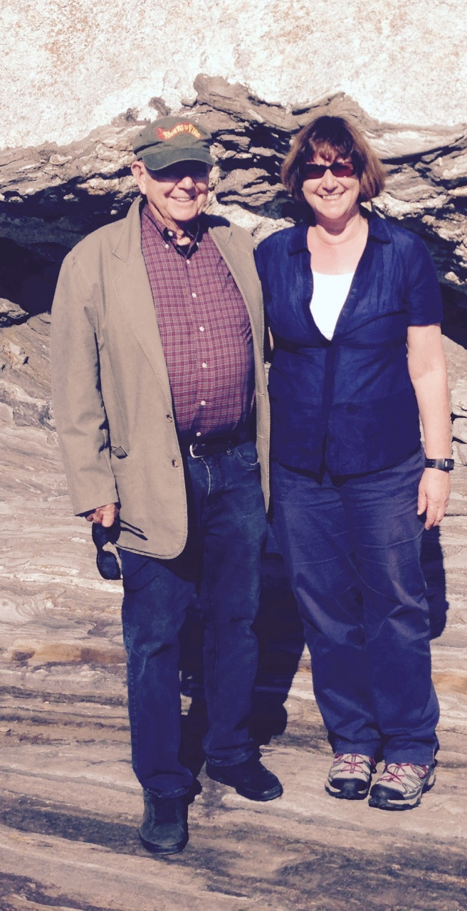
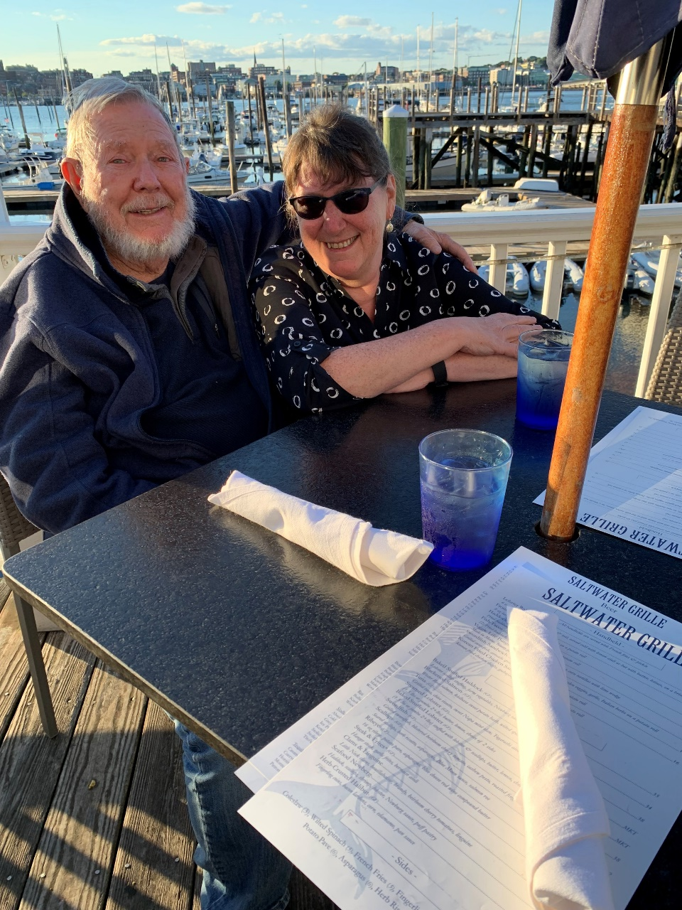
Visit with Jerry Gibbs in Maine, 2015 and 2019

Slide 18
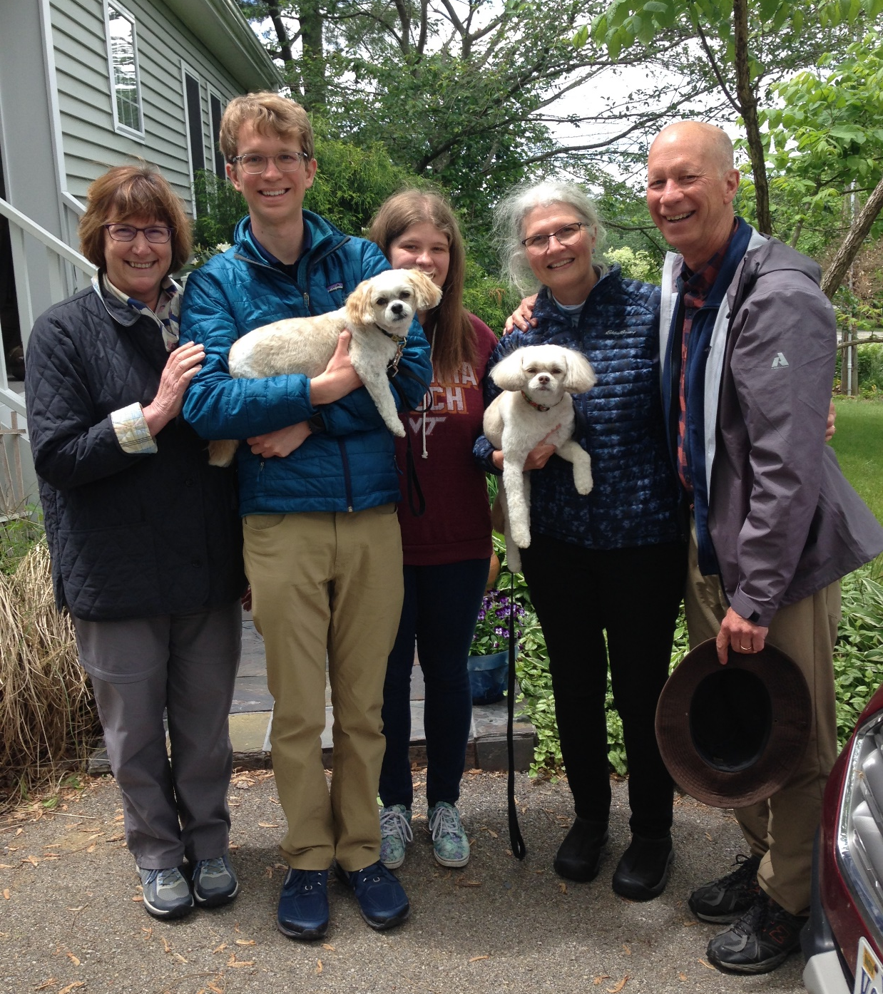
2019 visit with the Hochellas – Mike, Barb, Katherine, Michael Jr. and Abby and Coco

Slide 19
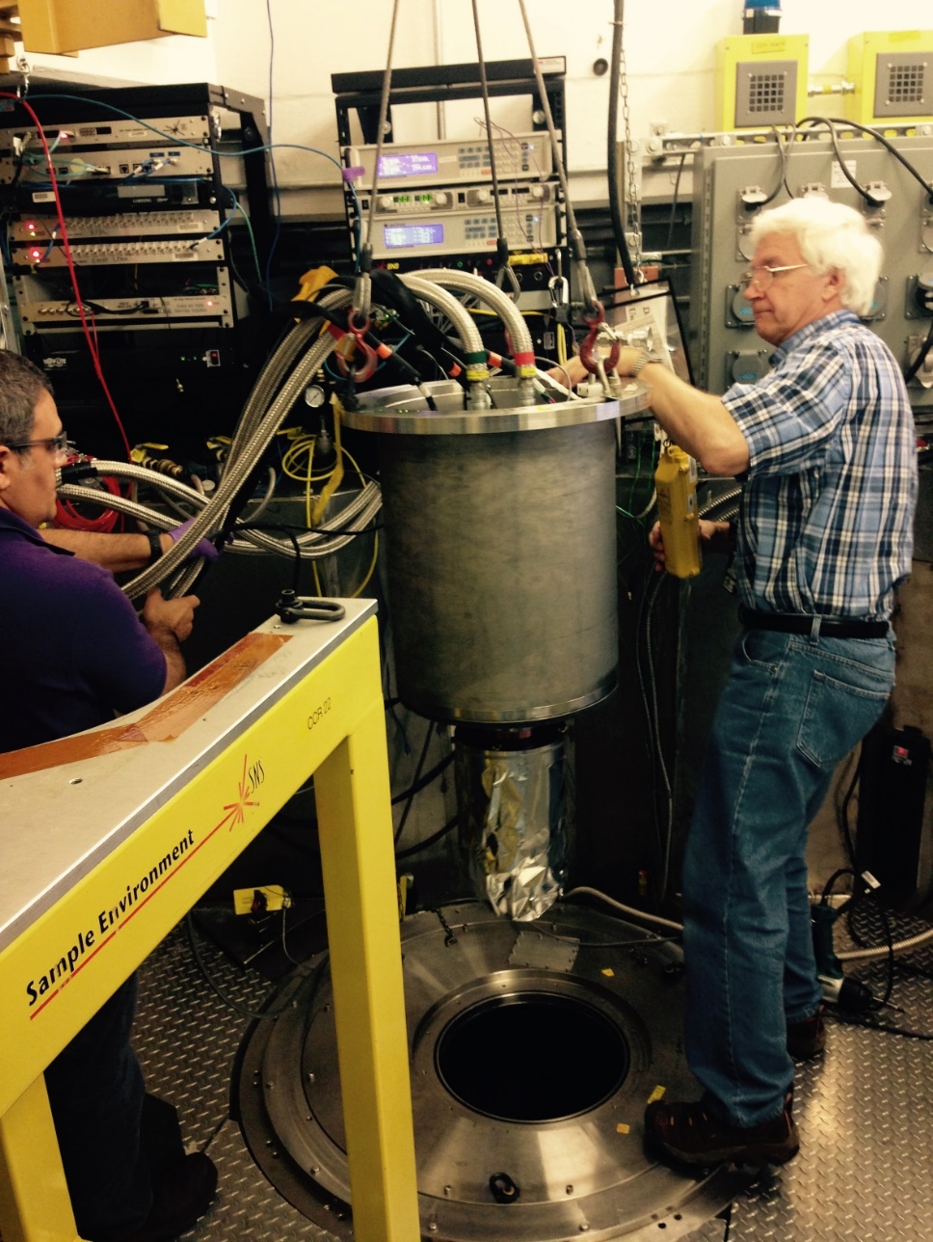

Experiments with Sasha Kolesnikov 2017

Slide 20
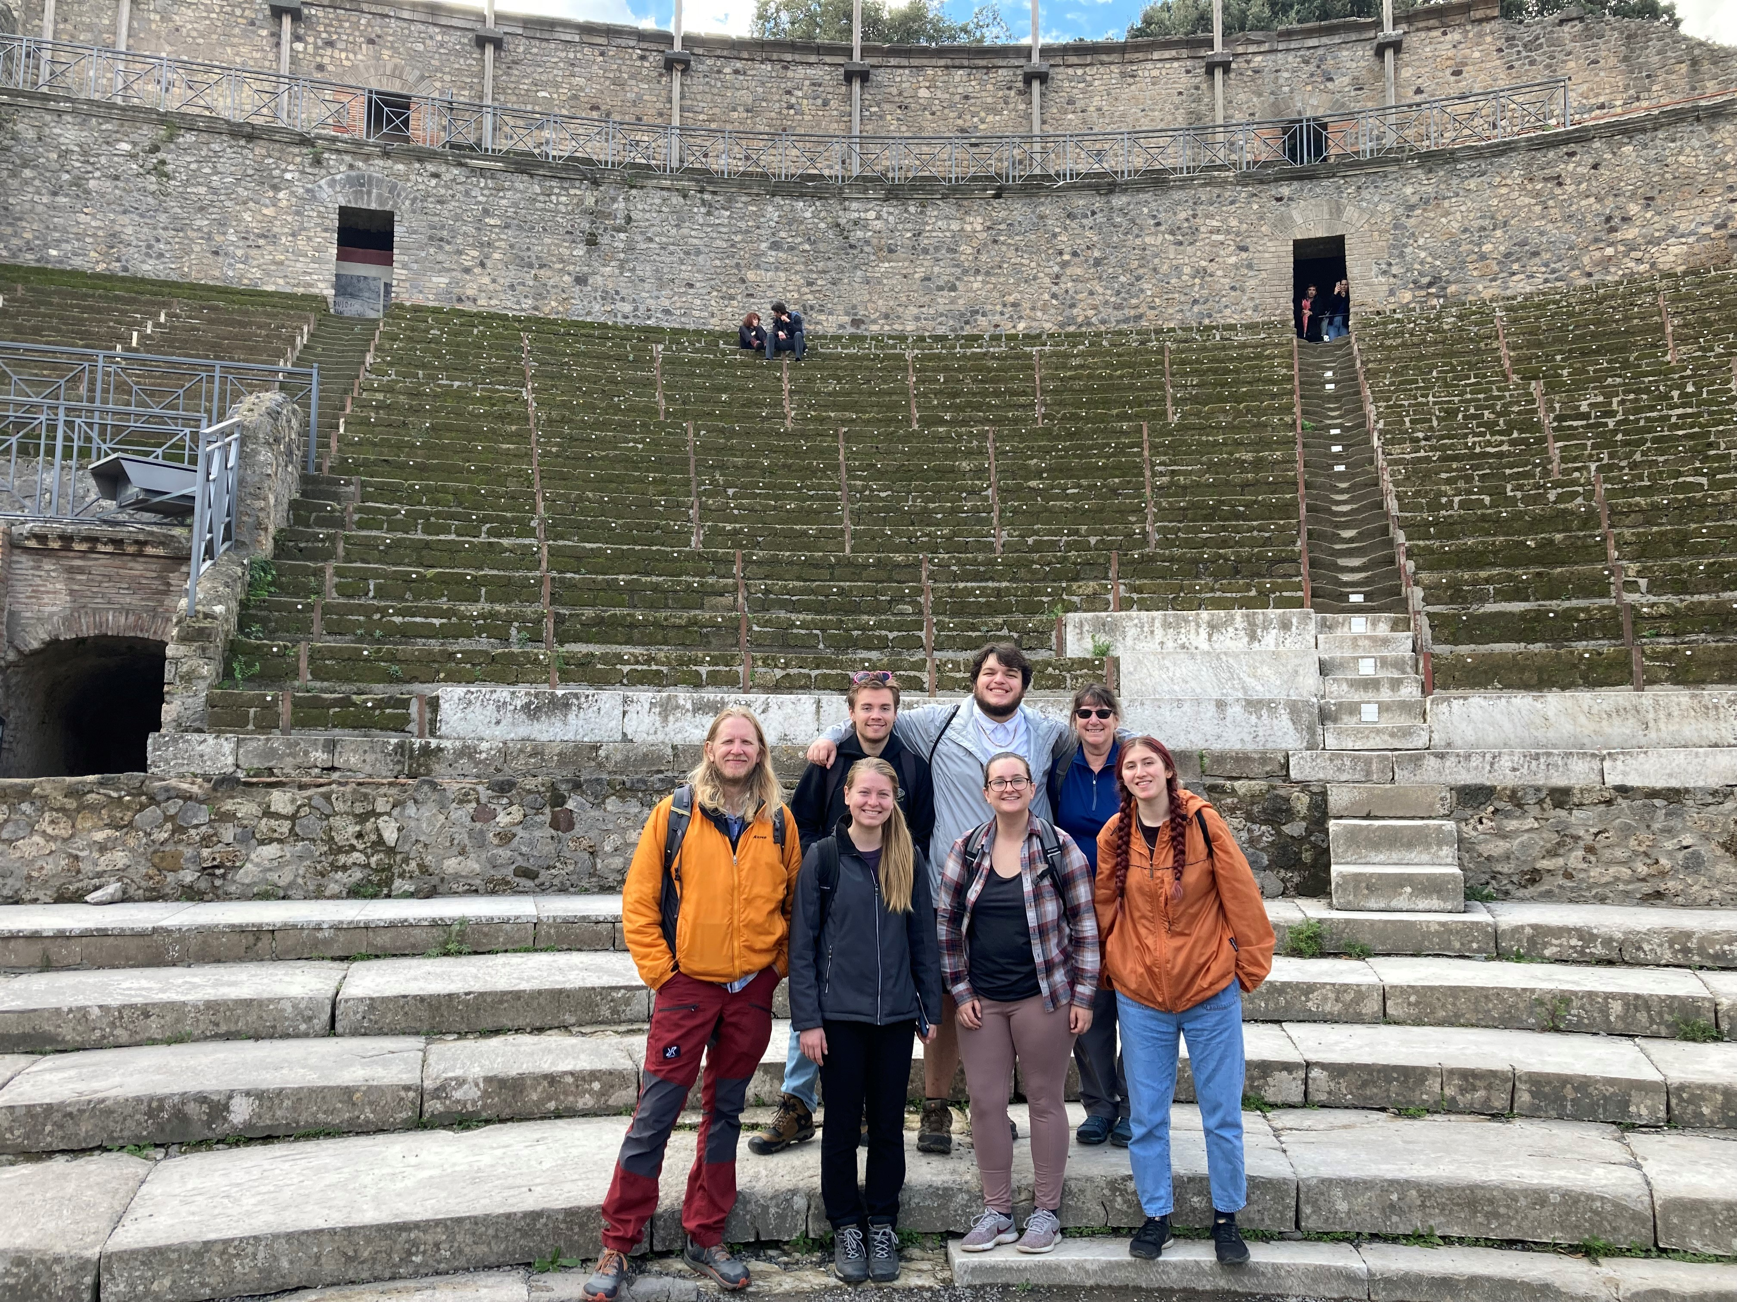
Pompeii with students in the 2022 Geosciences Study Abroad Program

Slide 21
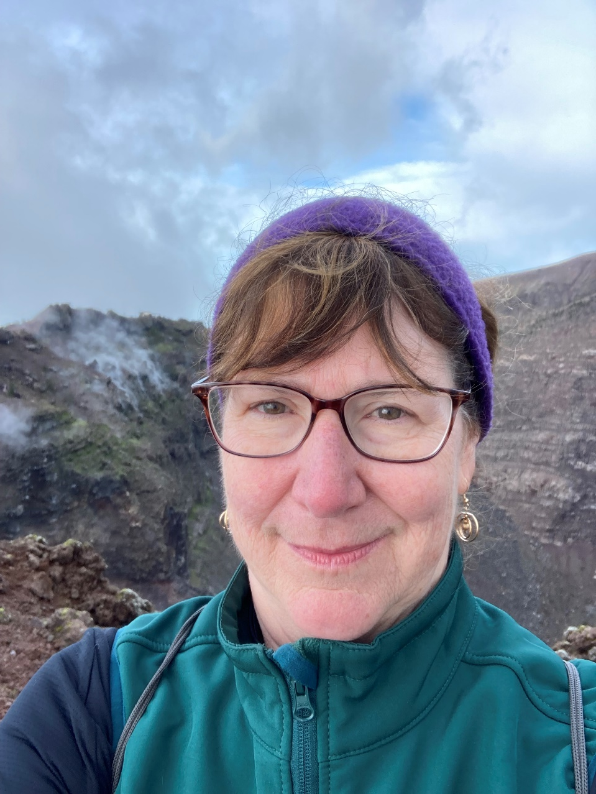
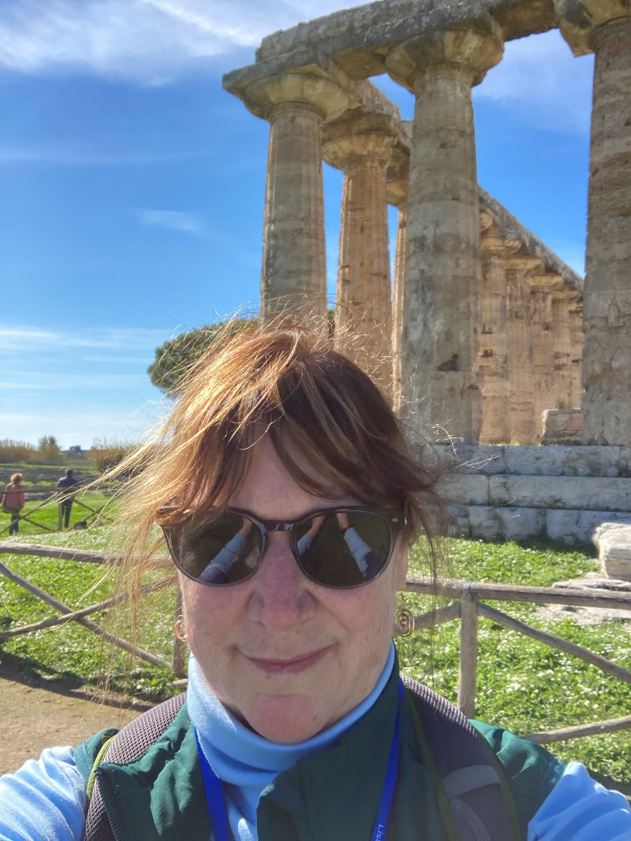
On rim of Vesuvius, Italy, 2021
At Paestum, Italy, 2022

Slide 22
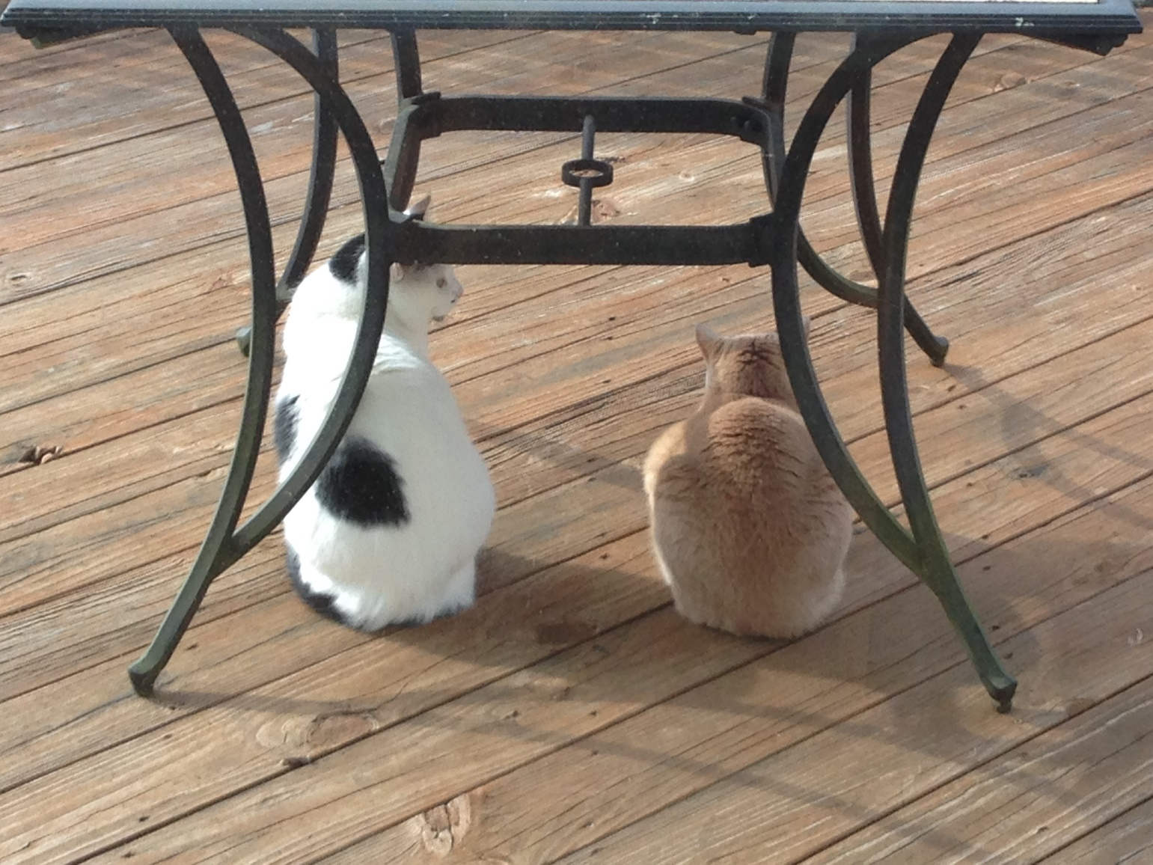
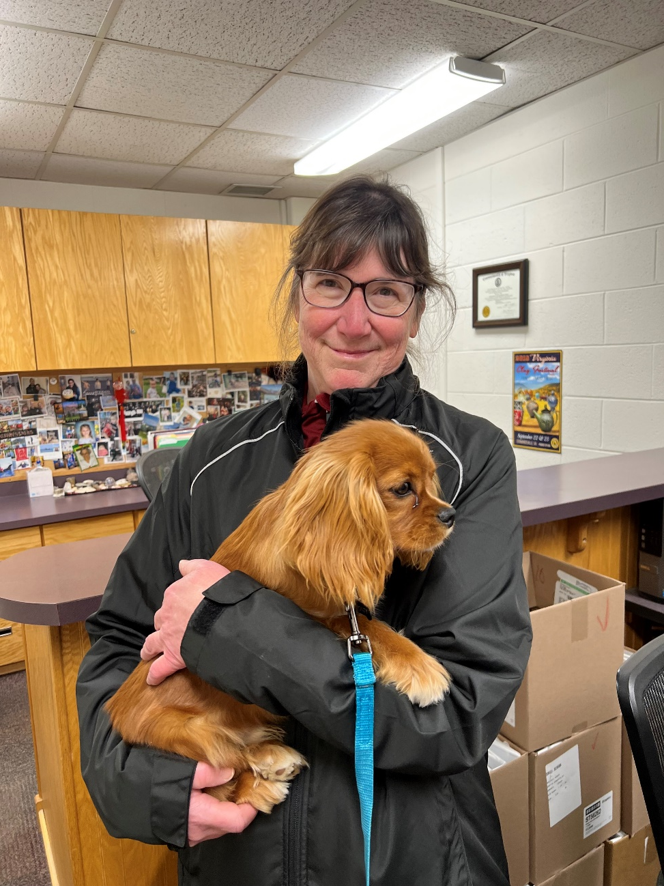
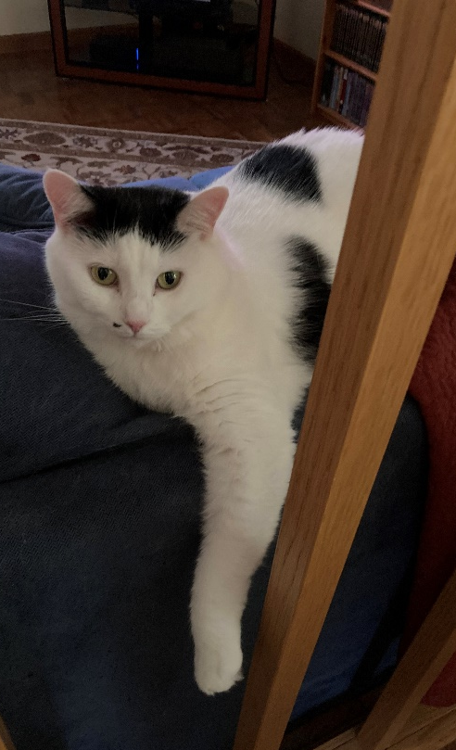
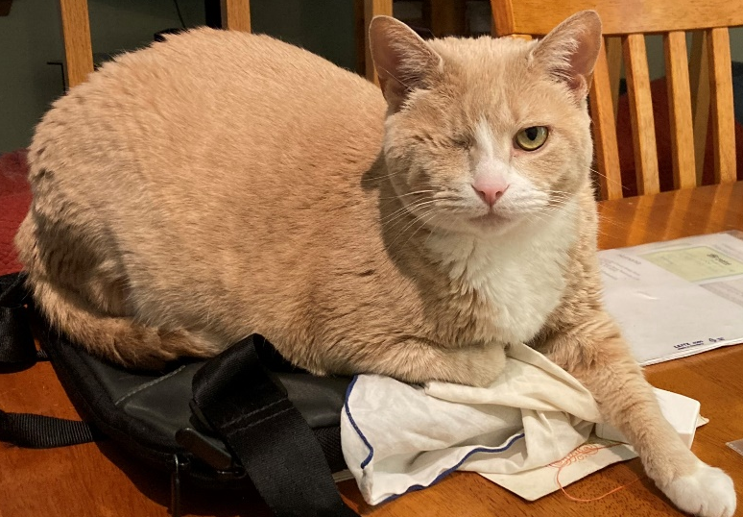
One-eyed Impy (aka “Zoom Cat”)
and Boo Boo
Department visitor

Slide 23
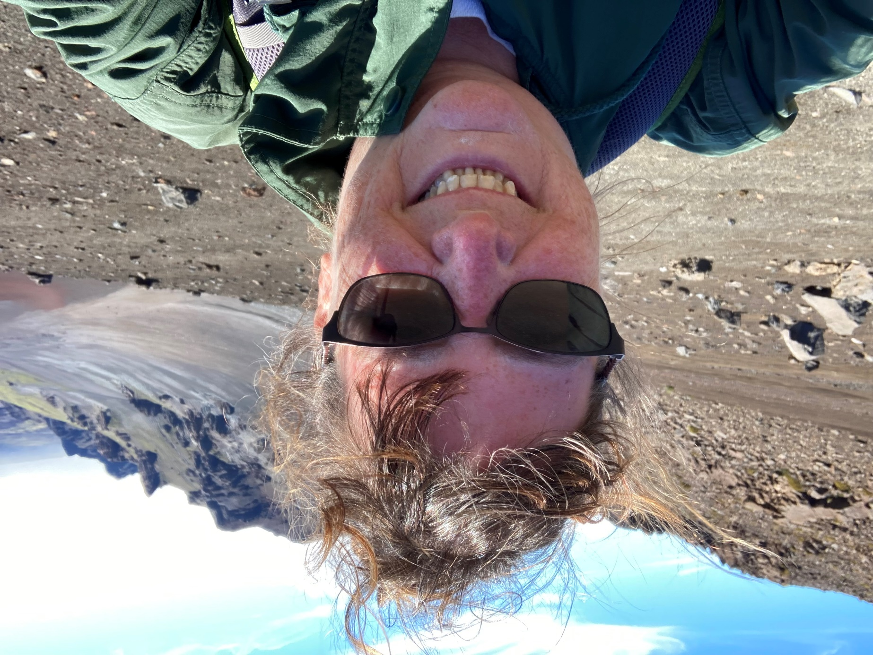
Hiking on Haleakalā volcano, Maui, 2022

Slide 24
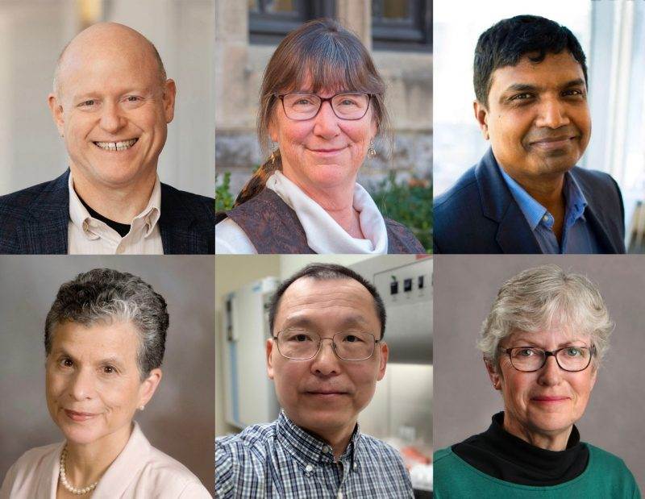
Six Virginia Tech faculty elected AAAS Fellows, 2024

Slide 25
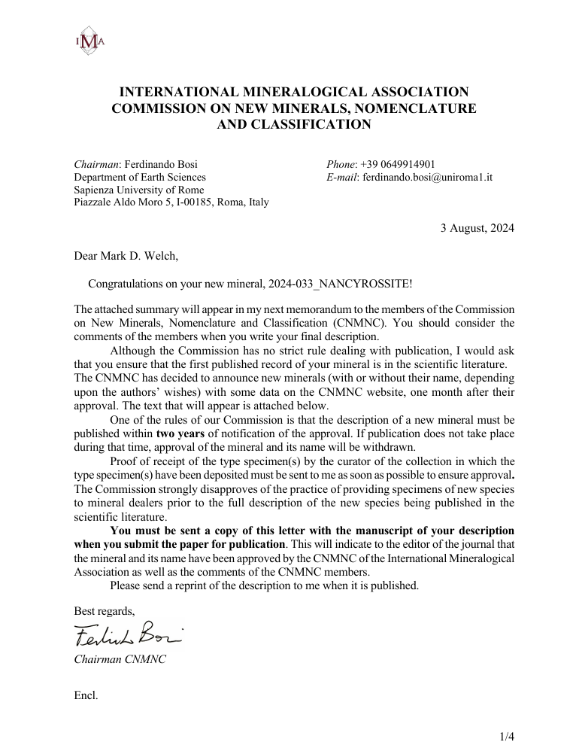
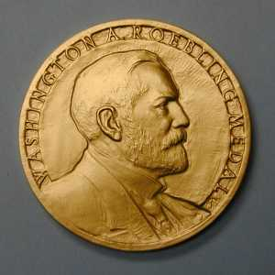
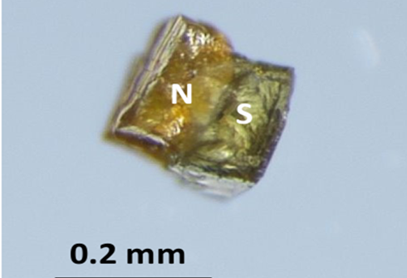
New mineral
Nancyrossite
2024 Roebling Medalist,
Mineralogical Society of America

