Slide 1
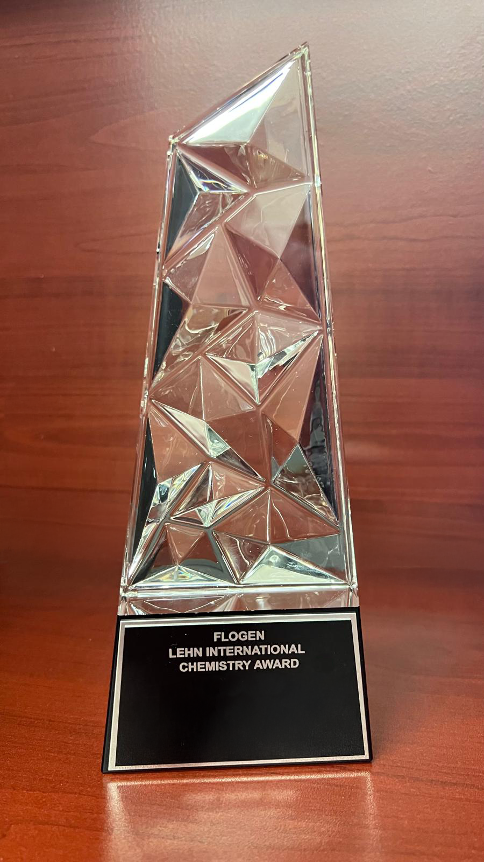
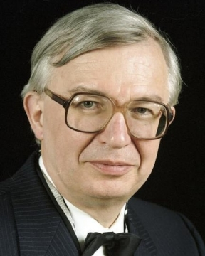
Lehn International Chemistry Award
In honor of the distinguished work and lifetime achievements of Dr. Jean-Marie Lehn and his contribution in Chemistry
Citation:
“For Leadership in developing and applying new chemical methods and technologies as per FLOGEN Sustainability Framework in the environmental, economic, and social points of view ”

Slide 2
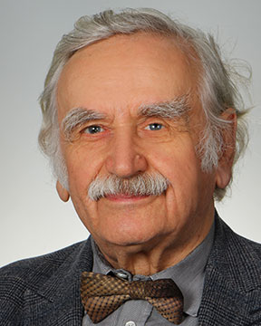
Sustainable Industrial Processing Summit
2024 STARS:
Janusz Lipkowski
Professor
Cardinal Stefan Wyszynski University, Poland
Field: Physical Chemistry
LEHN INTERNATIONAL CHEMISTRY AWARD
FLOGEN STARS OUTREACH

Slide 3
Dr. Janusz Lipkowski receiving the Lehn International Chemistry Award from Dr. Florian Kongoli at FLOGEN SIPS 2024

Slide 4
Dr. Janusz Lipkowski delivering an acceptance speech during the FLOGEN SIPS 2024 award ceremony

Slide 5
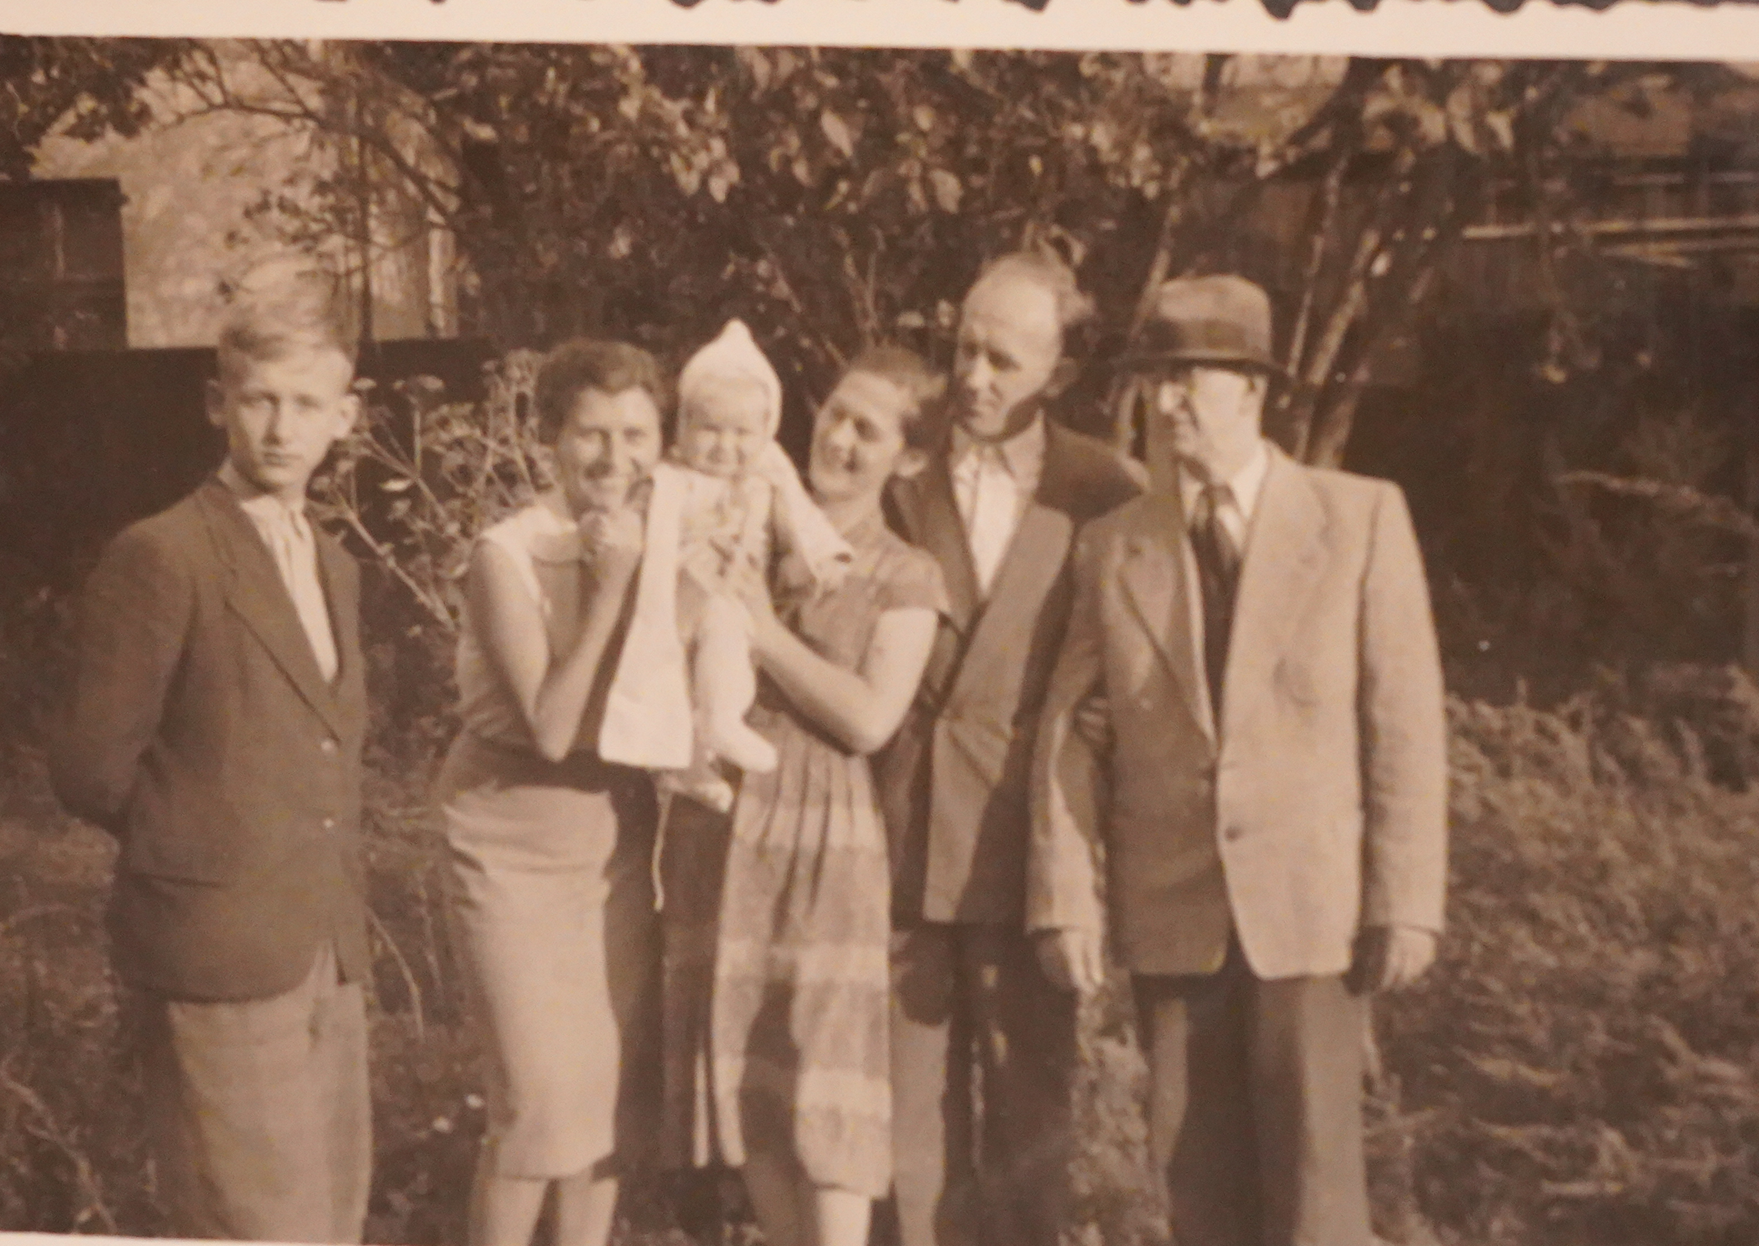
Family meeting, from the right: my grandfather, unckle and aunts…

Slide 6
With parents and younger brother and sister
1952

Slide 7
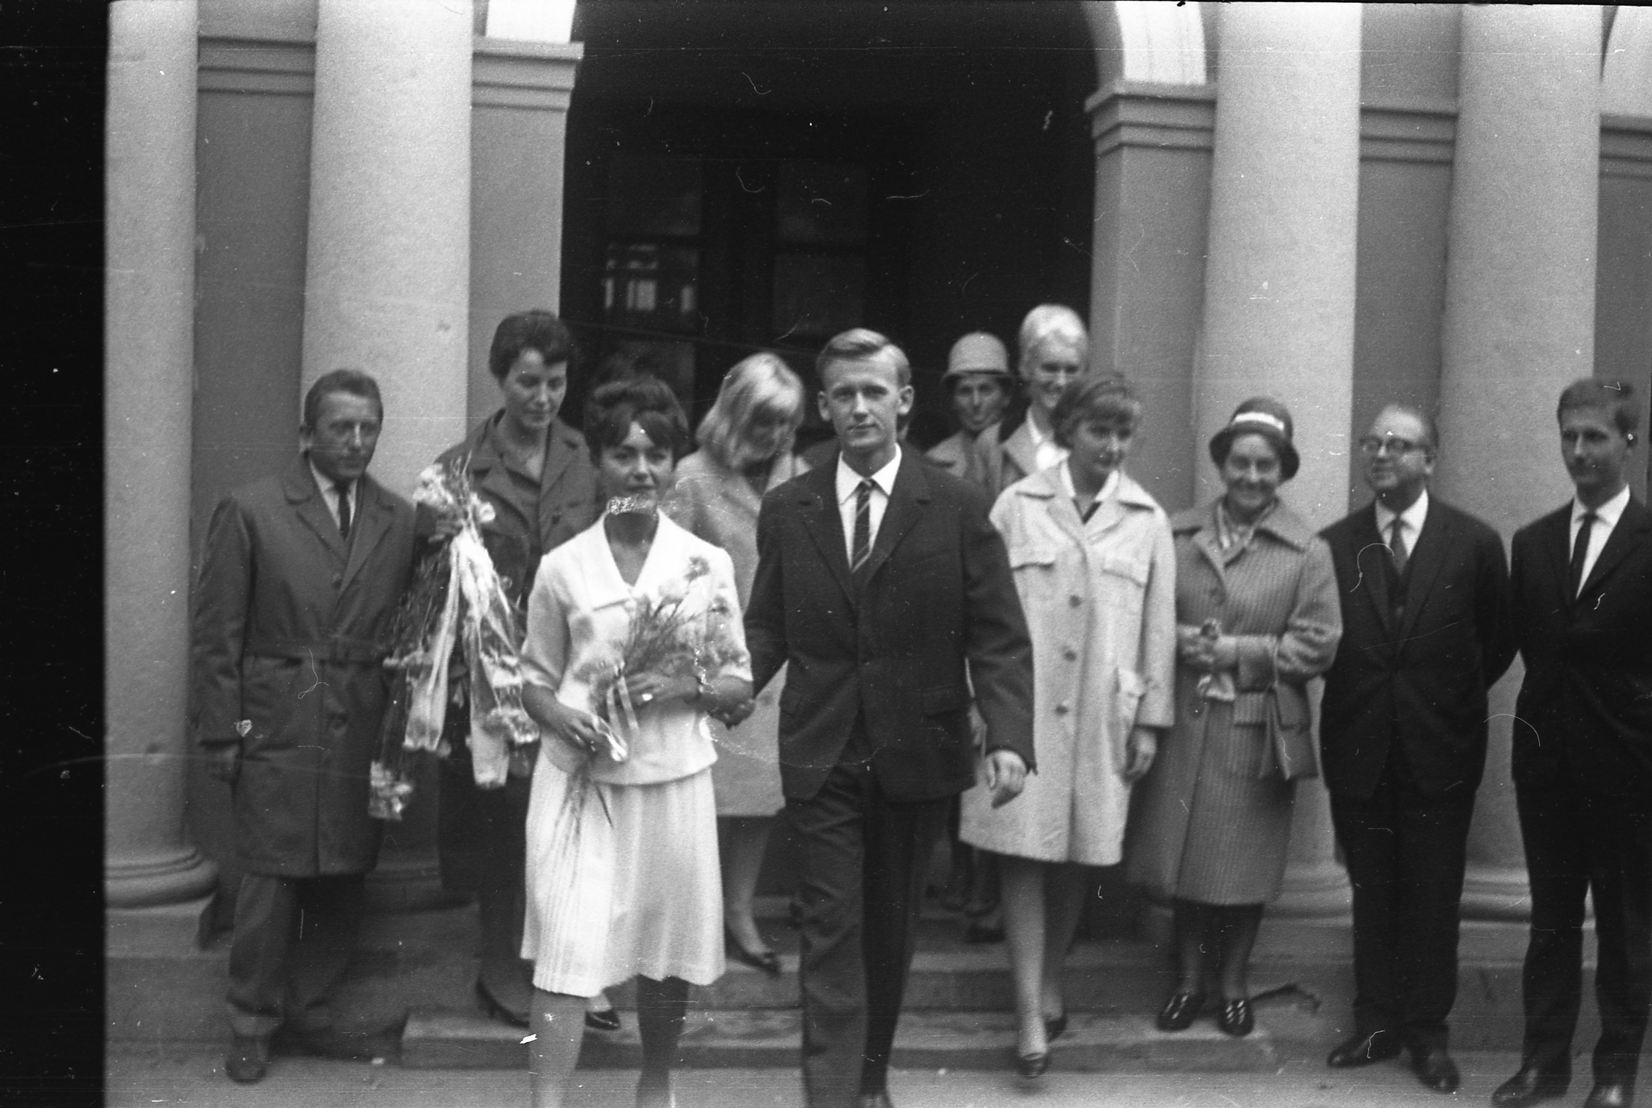
Marriage with Krystyna 1064

Slide 8
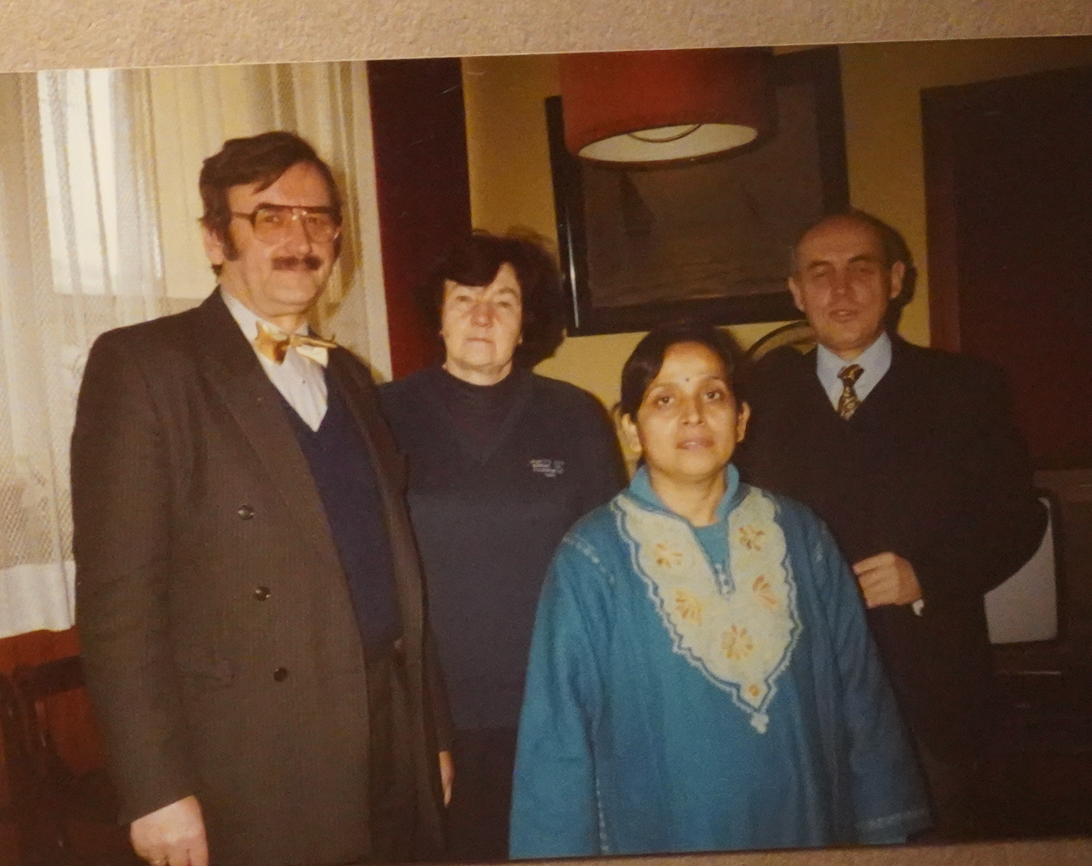
JL – director Anna Grabowska anf Jerzy Pielaszek (deputies)deputy with an Indian PhD student
1996

Slide 9
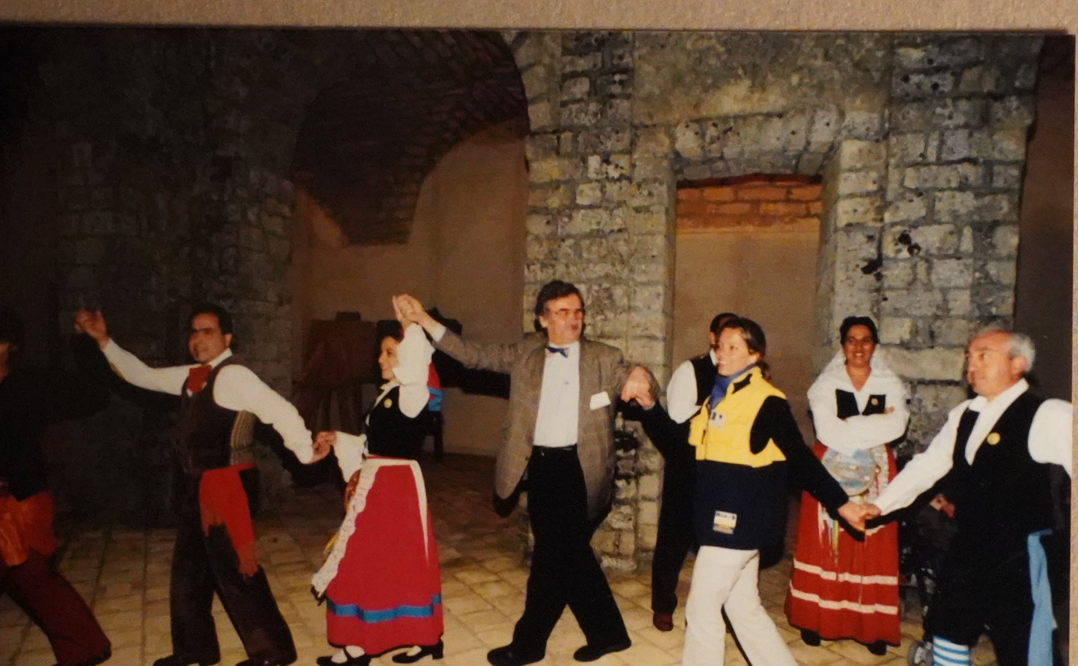
Erice (Italy)
Conference entertainment

Slide 10
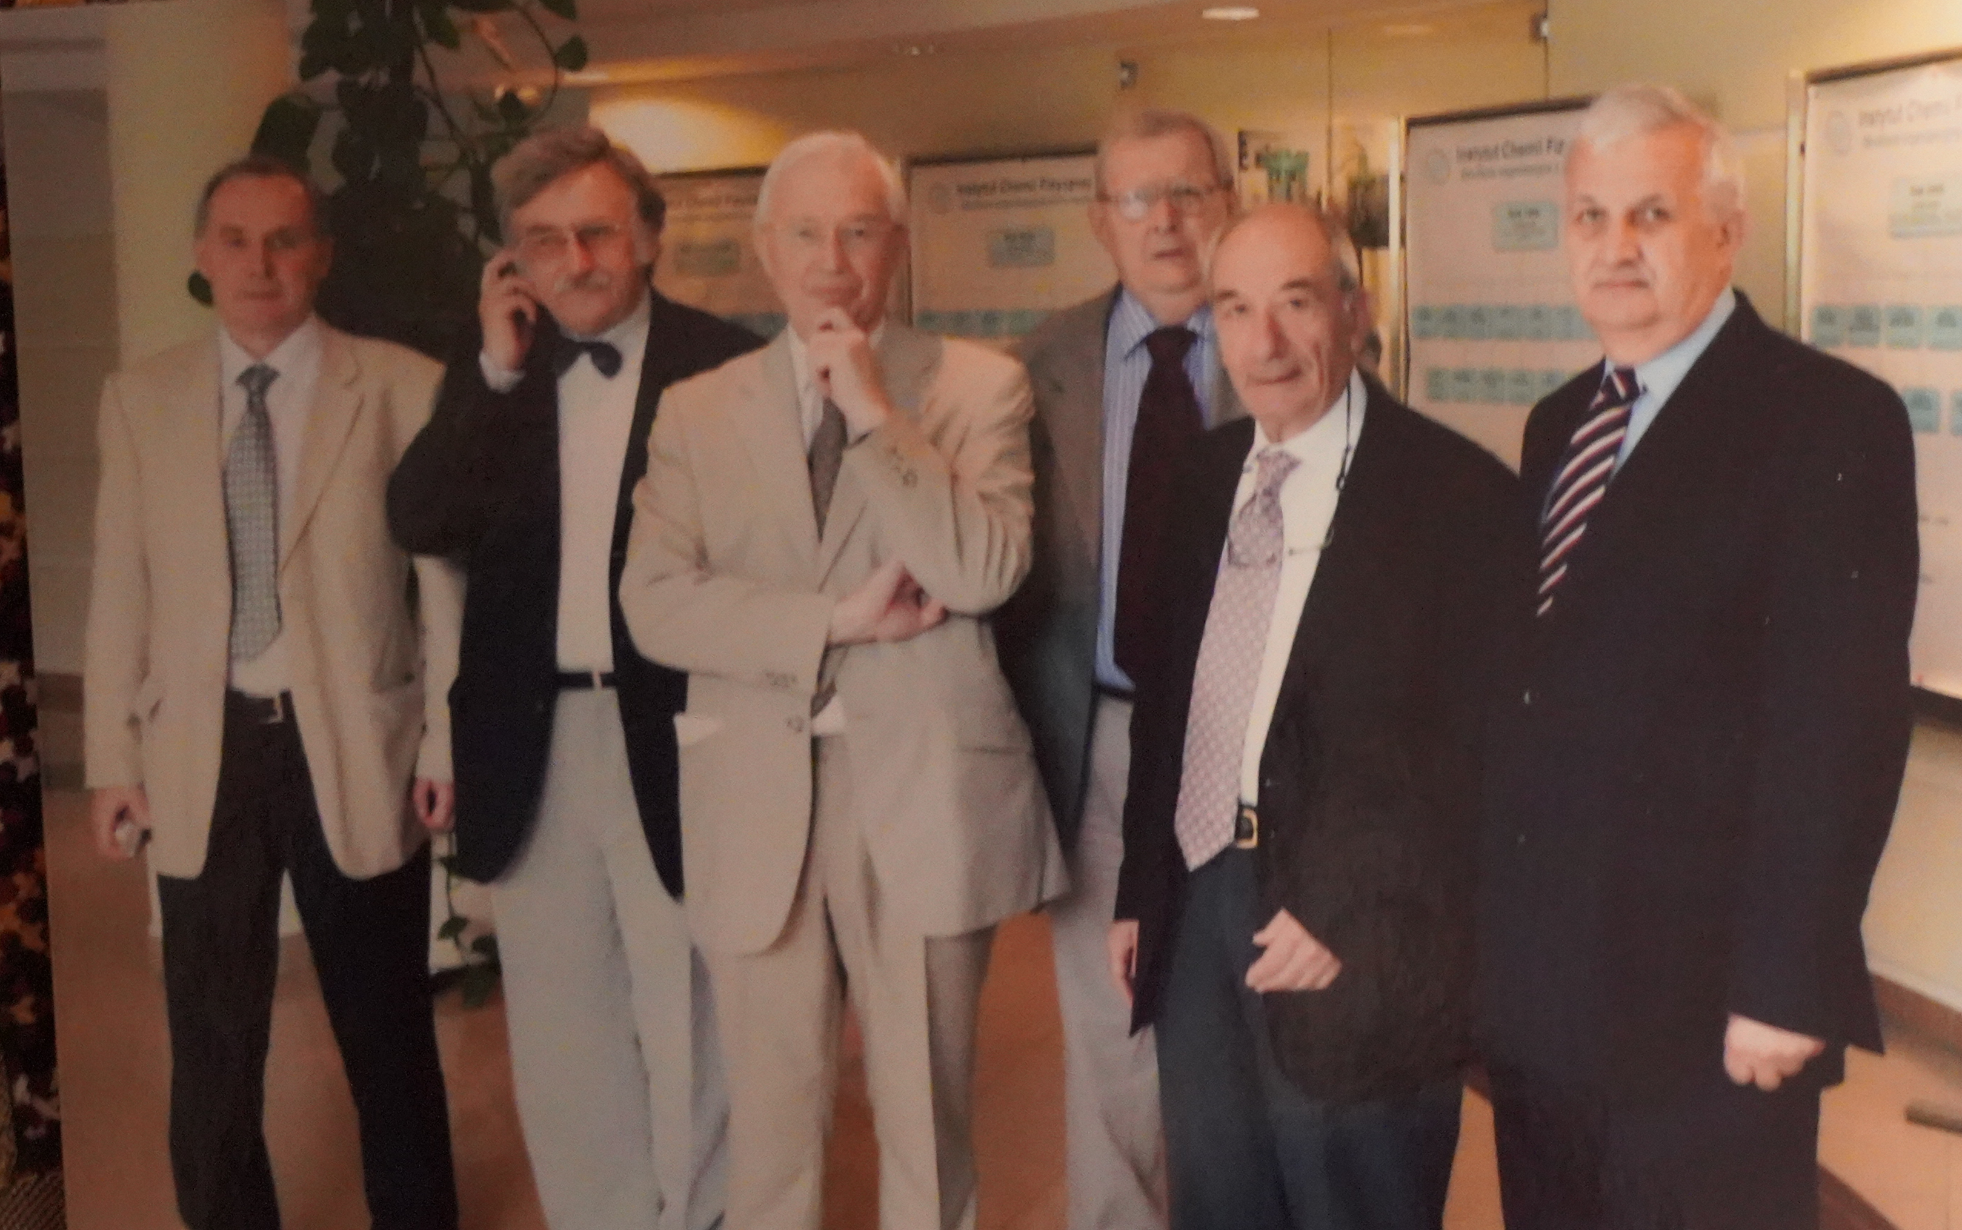
In the Institute:
Vitaly Kalchenko, JL,, Jean-Marie Lehn, Yurij Simonov and Georgres Tsoucaris

Slide 11
With granson Jaś in the Museum of railways, 2006

Slide 12
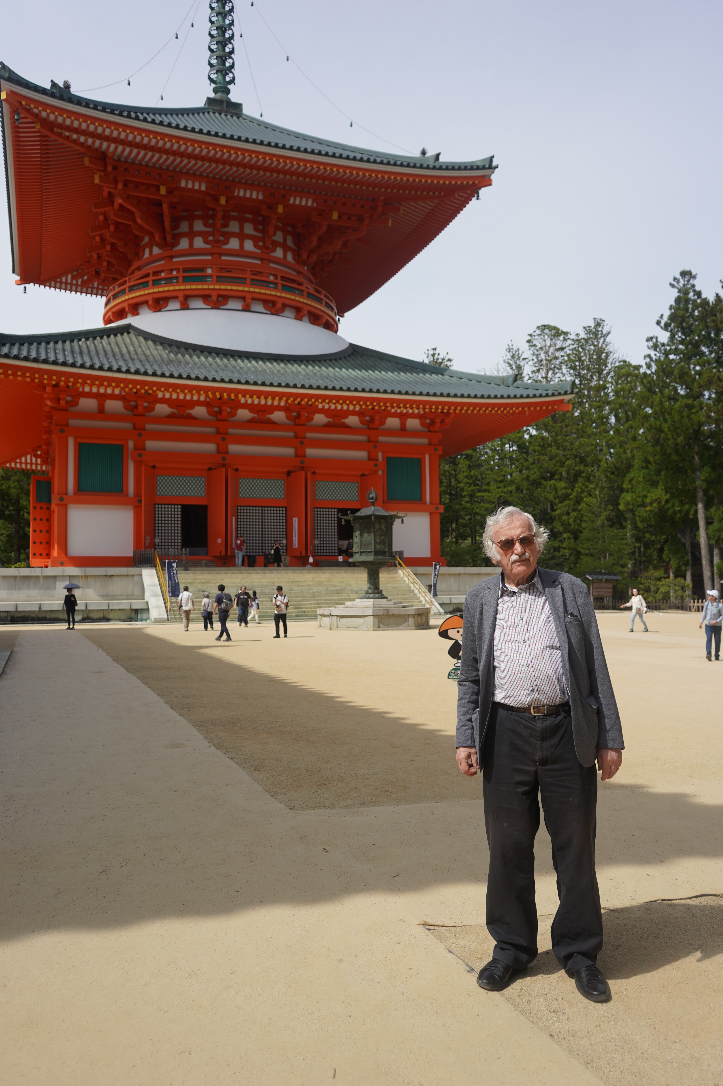
Japan, Osaka – Koyasan 2024

